Slide 1
Java for FTC
Session 4: Subsystems!!!

Slide 2
Overview
Servos – Claw
Making a good gamepad configuration
Elevator
Starting the grand reprogram

Slide 3
Tell me what you know what you really really know
I’ll tell you what I know what I really really know
I knowa, (ha) I knowa, (ha) I knowa, (ha) I knowa, (ha) I knowa really, really, really knowa zigazig ah

Slide 4
Tell me what you know:
In FTC programming, which of the following gamepad elements returns a double value? A) gamepad1.a B) gamepad1.b C) gamepad1.left_stick_y D) gamepad1.dpad_left
What is the purpose of using @Override in your OpMode code? A) It allows loop to run twice as fast B) It disables methods C) It informs the compiler you are replacing a superclass method D) It initializes all variables, overriding class variables
When configuring motor control, why is it not ideal set motor properties directly inside the loop() method? A) It slows the robot down B) It violates encapsulation principles and is less reusable C) It disables telemetry D) It's required by the SDK
Multiple Choice (Select the best answer)
What is the function of the init() method in an FTC OpMode? A) It sends telemetry data continuously B) It initializes hardware once C) It controls the loop frequency D) It defines robot motor behavior during autonomous
Which of the following is not a primitive data type in Java? A) int B) double C) String D) boolean
What value will be stored in int result = 7 / 2;? A) 3.5 B) 4 C) 3 D) 2.5
Telling me what you know

Slide 5
Tell me what you know:
In FTC programming, which of the following gamepad elements returns a double value? A) gamepad1.a B) gamepad1.b C) gamepad1.left_stick_y D) gamepad1.dpad_left
What is the purpose of using @Override in your OpMode code? A) It allows loop to run twice as fast B) It disables methods C) It informs the compiler you are replacing a superclass method D) It initializes all variables, overriding class variables
When configuring motor control, why is it not ideal set motor properties directly inside the loop() method? A) It slows the robot down B) It violates encapsulation principles and is less reusable C) It disables telemetry D) It's required by the SDK
Multiple Choice (Select the best answer)
What is the function of the init() method in an FTC OpMode? A) It sends telemetry data continuously B) It initializes hardware once C) It controls the loop frequency D) It defines robot motor behavior during autonomous
Which of the following is not a primitive data type in Java? A) int B) double C) String D) boolean
What value will be stored in int result = 7 / 2;? A) 3.5 B) 4 C) 3 D) 2.5
Telling me what you know

Slide 6
Tell me what you know:
Briefly describe the difference between a TeleOp and an Autonomous OpMode. Include when each is used and how they differ structurally.
Explain how encapsulation is used when designing robot subsystems in FTC Java programming. Include how access modifiers like private and public help structure your code.
Explain what a class is in Java and describe how classes are used in FTC programming to organize robot code. Provide an example of a class you might create for a robot subsystem.
Telling me what you know

Slide 7
Tell me what you know:
What is inheritance in Java? How does the concept of inheritance apply to FTC OpModes, particularly in how you write a class that extends OpMode?
Describe the standard naming conventions for variables in Java. Why is it important to follow these conventions in FTC code, especially when collaborating with teammates?
Telling me what you know

Slide 8
From Android Studio to the robot
Let’s go!!!!!

Slide 9
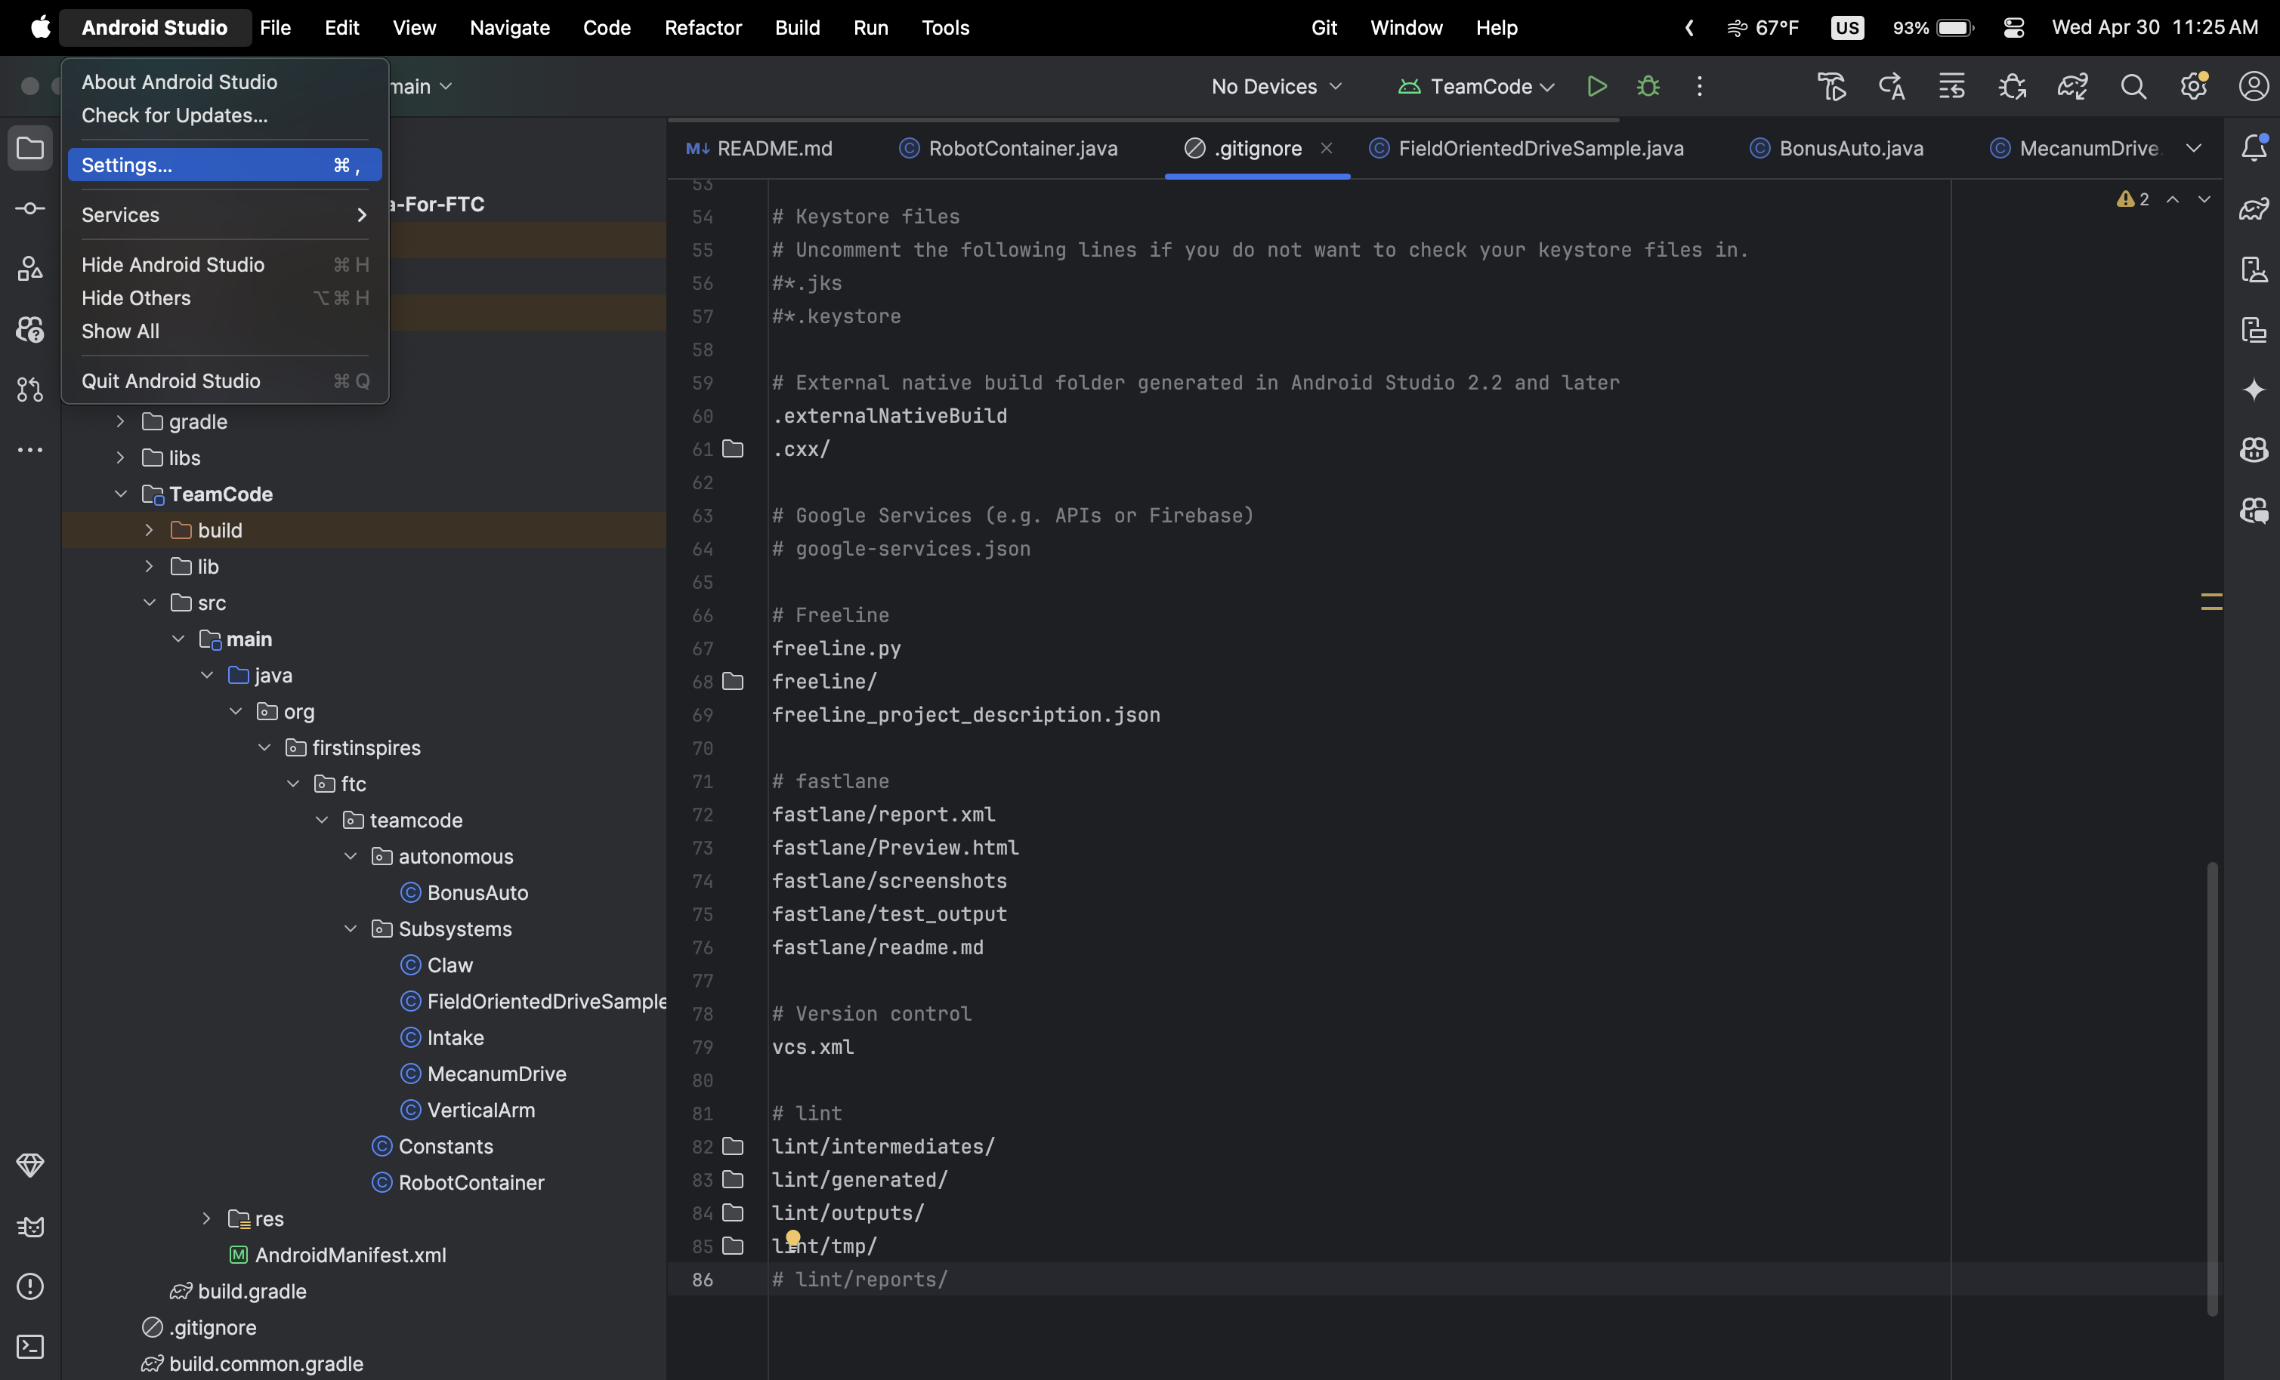

Slide 10
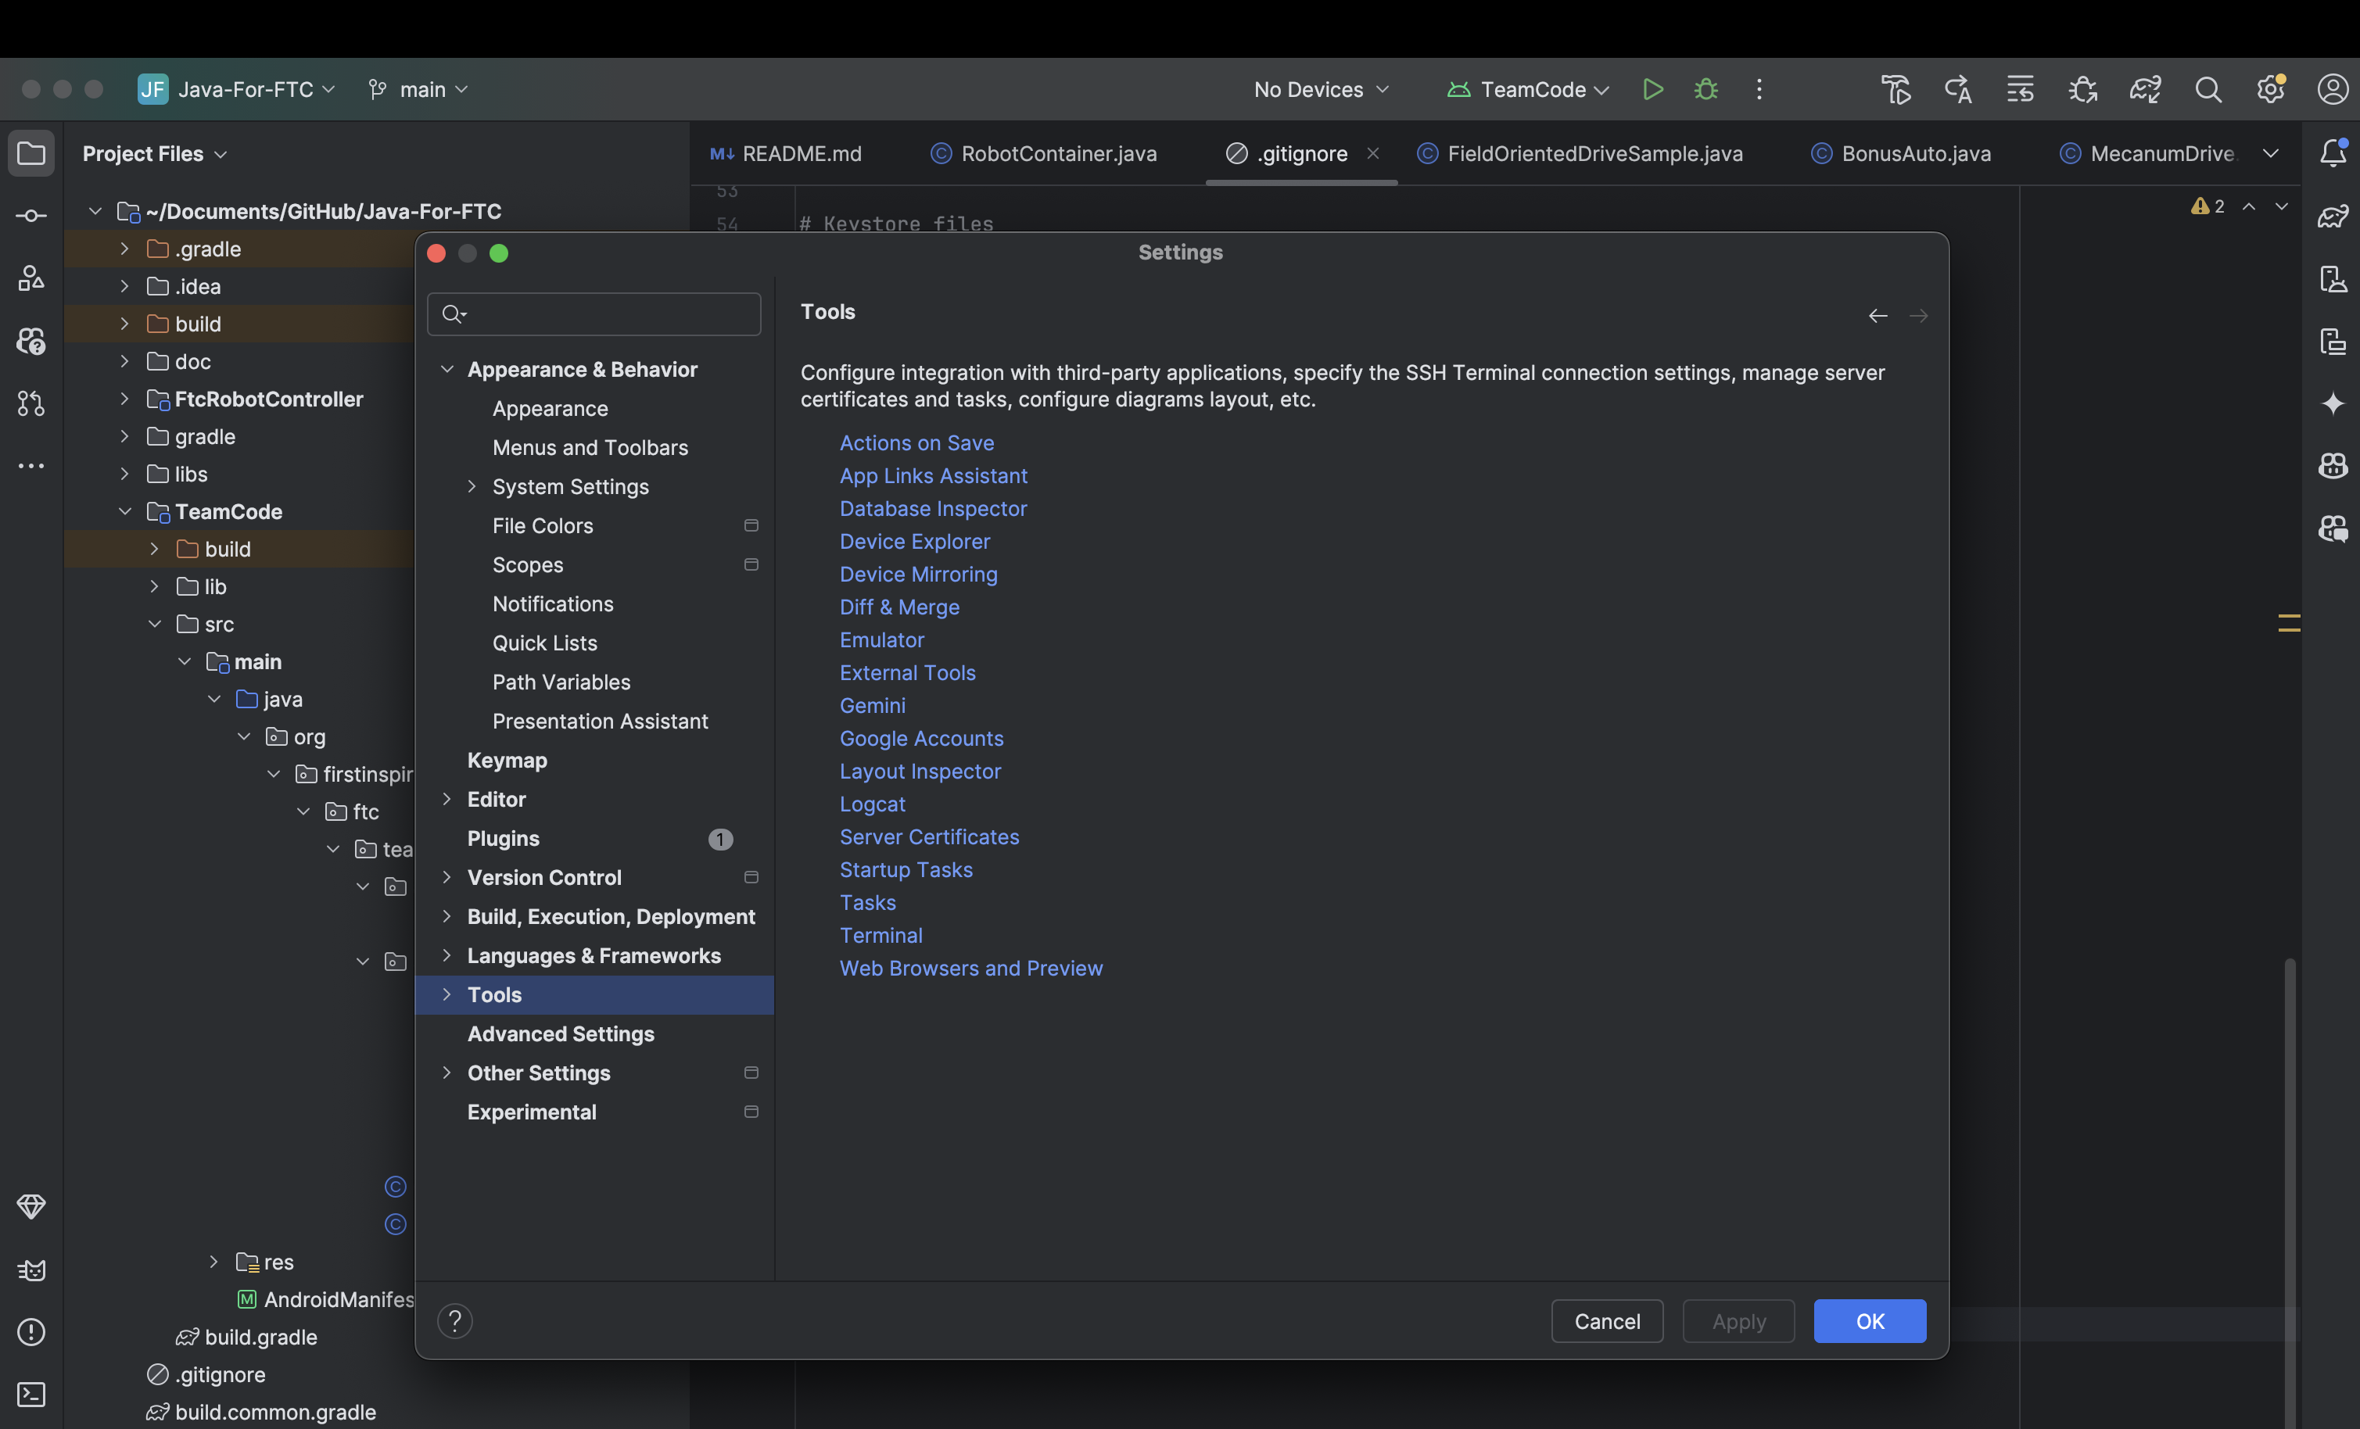

Slide 11
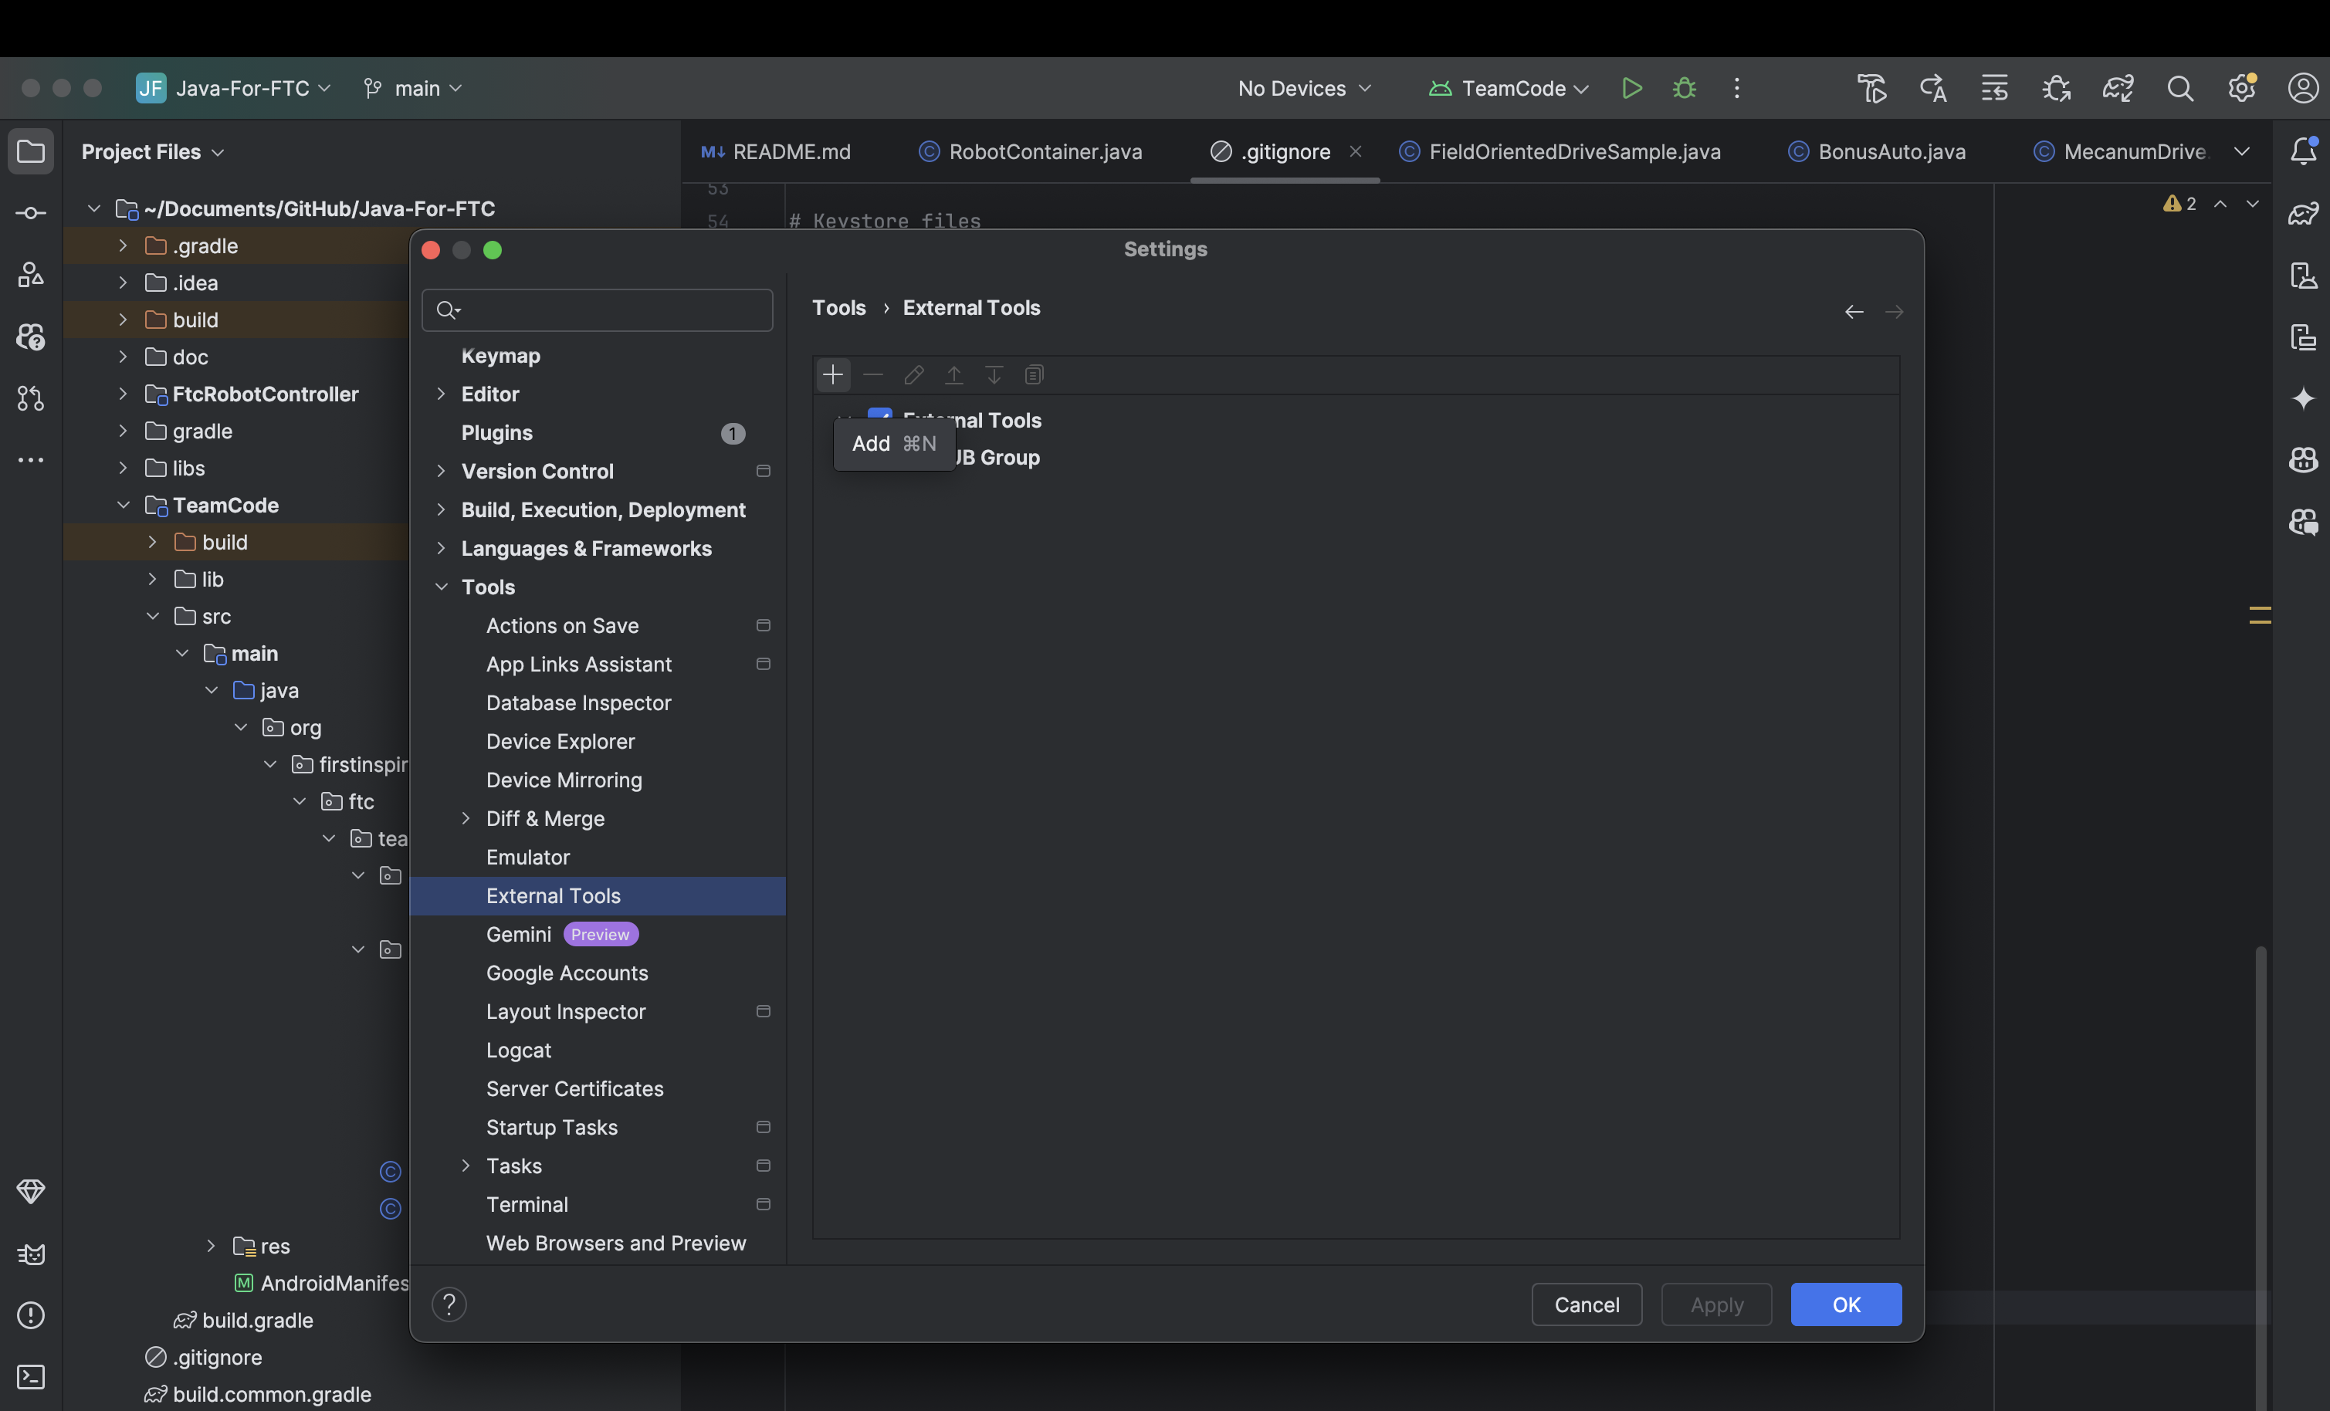

Slide 12
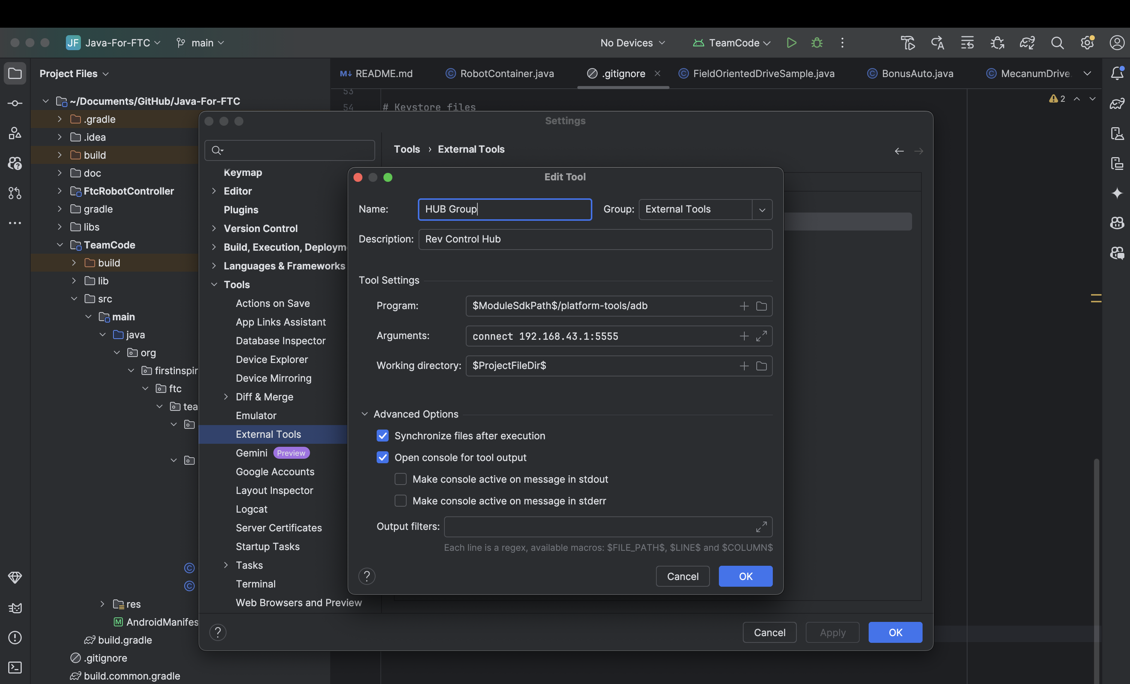

Slide 14
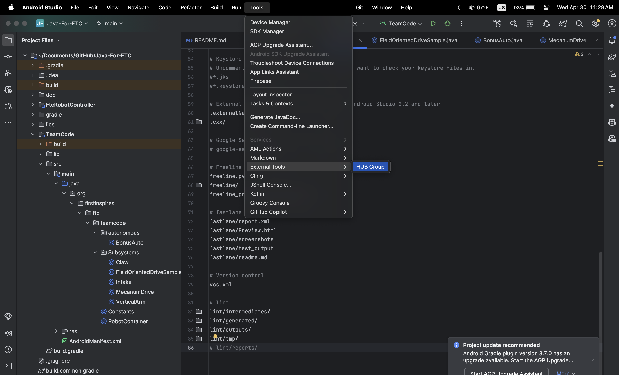
(Connect to the robot)

Slide 15
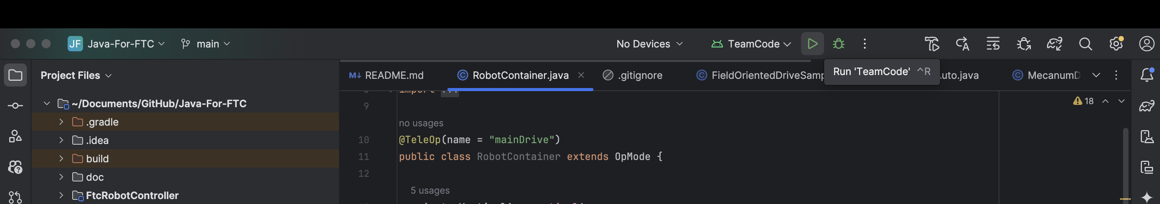
(Connect to the robot)
<-- Should say Rev something .

Slide 16
Servos – Intake & Outtake
Motors but basic

Slide 17
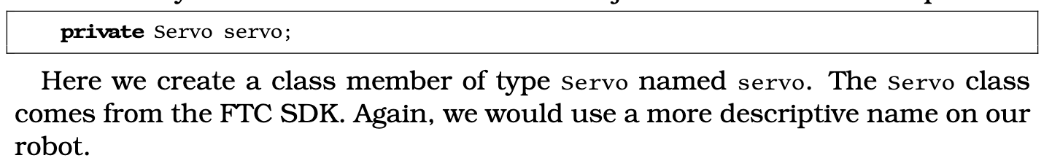
Servos, motors but different…
Servos

Slide 18
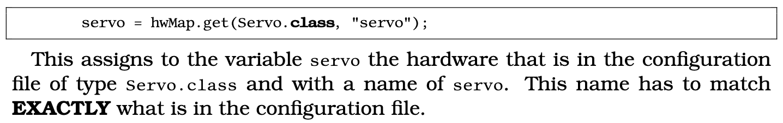
Servos, motors but different…
Servos

Slide 19
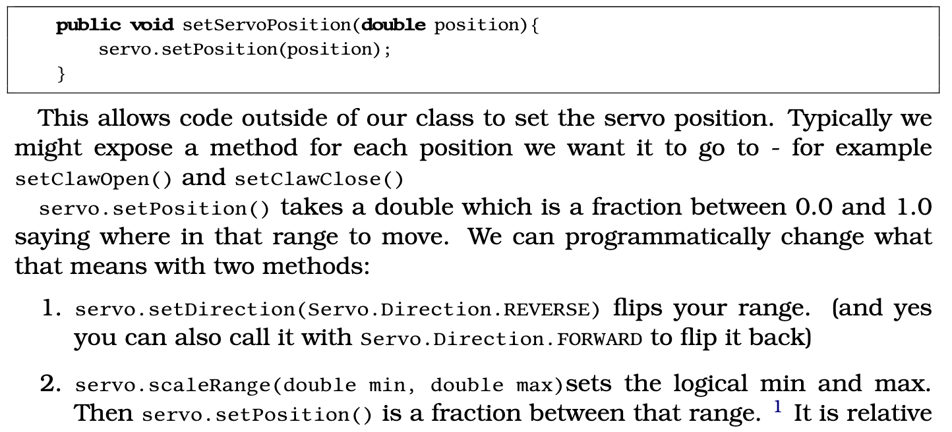
Servos, motors but different…
Servos

Slide 20
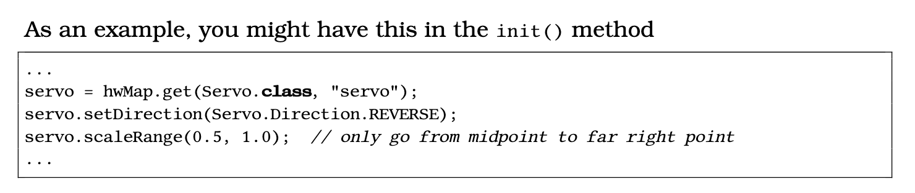
Servos, motors but different…
Servos

Slide 21
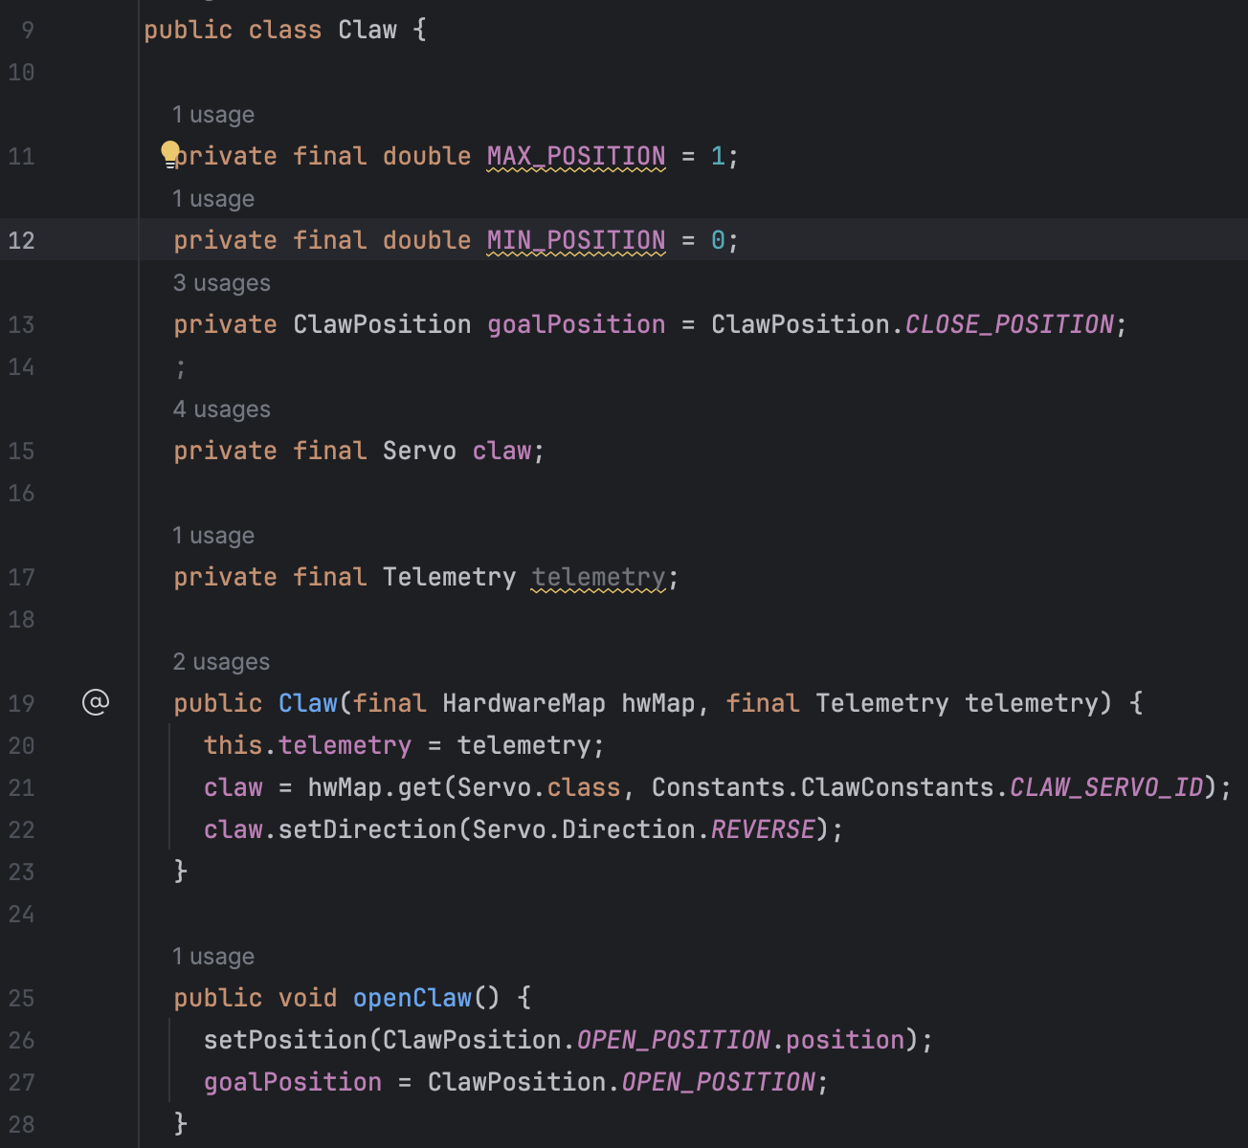
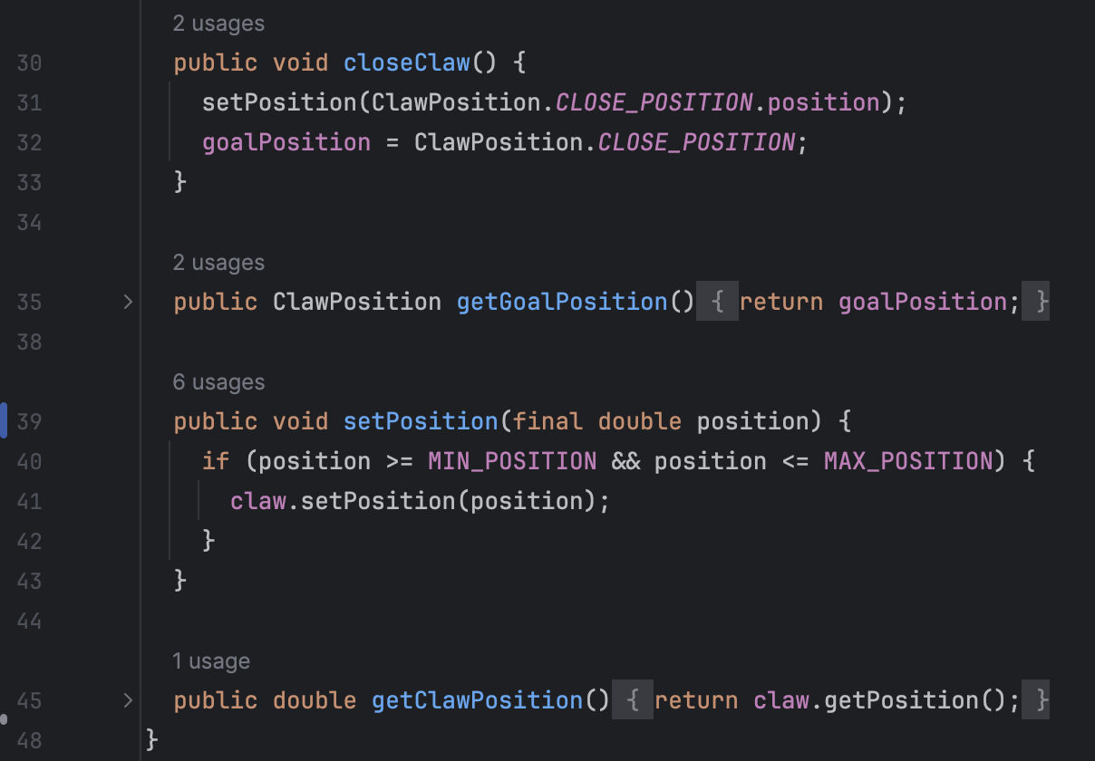
Servos – The claw
← Not needed but generally nice to have
Servos

Slide 22
Servos – The claw
Now you! This might help → Constants.ClawConstants.CLAW_SERVO_ID
Can you make a servo subsystem that will…
Go to position 1 when gamepad1 a button pressed.
Go to position 0 when gamepad1 b button pressed.
Go to position 0.5 if the user isn’t actively holding down a or b.
Go to a position based on the left y joystick.
Note that you don’t need to consider the user
pressing multiple buttons at once.
Servos

Slide 23
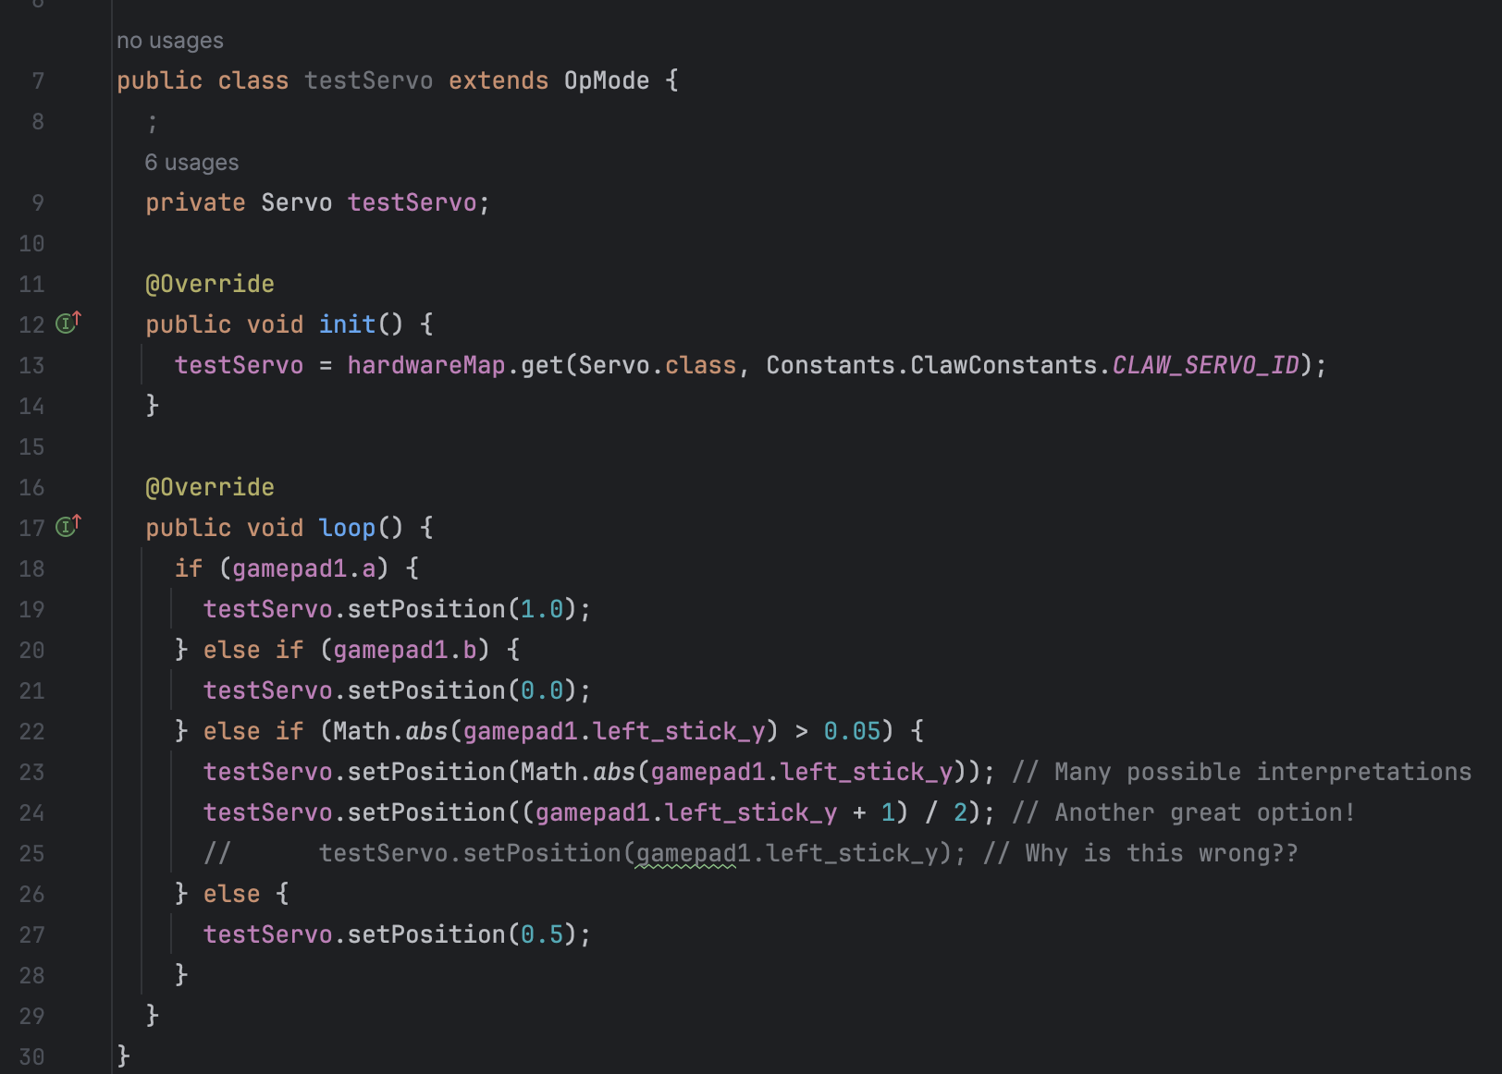
Servos – The claw
Servos

Slide 24
Gamepad layout thoughts
It’s just this slide lol

Slide 25
Elevator

Slide 26
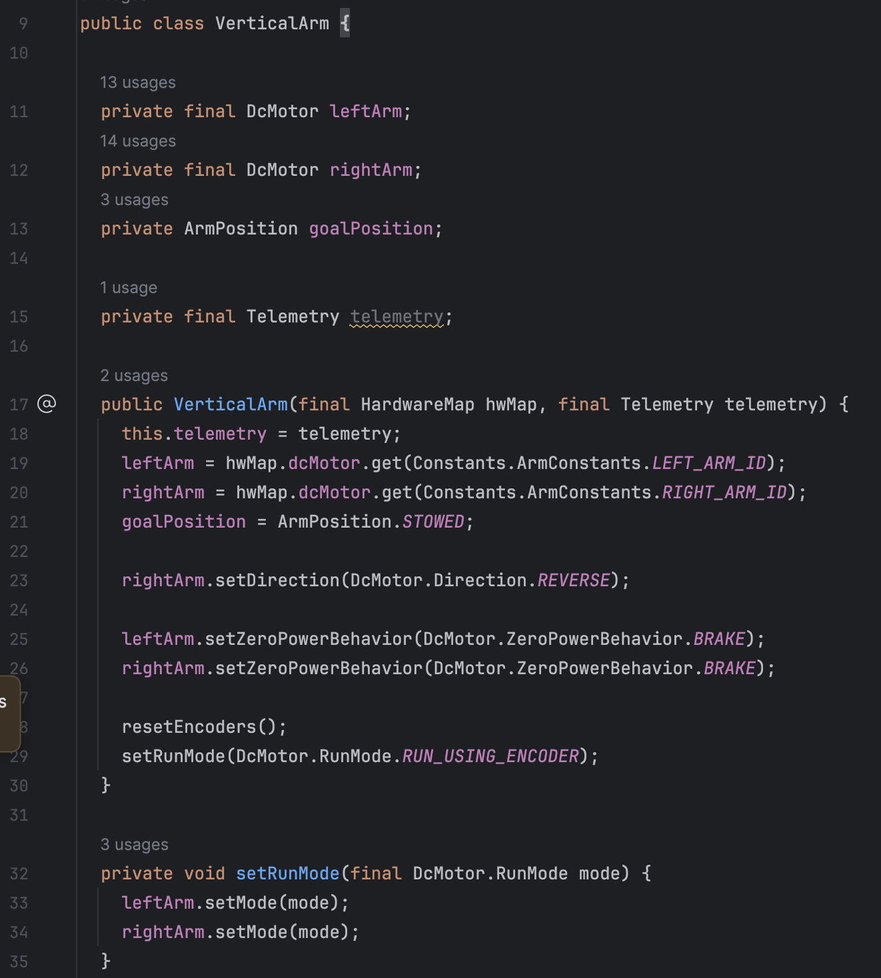
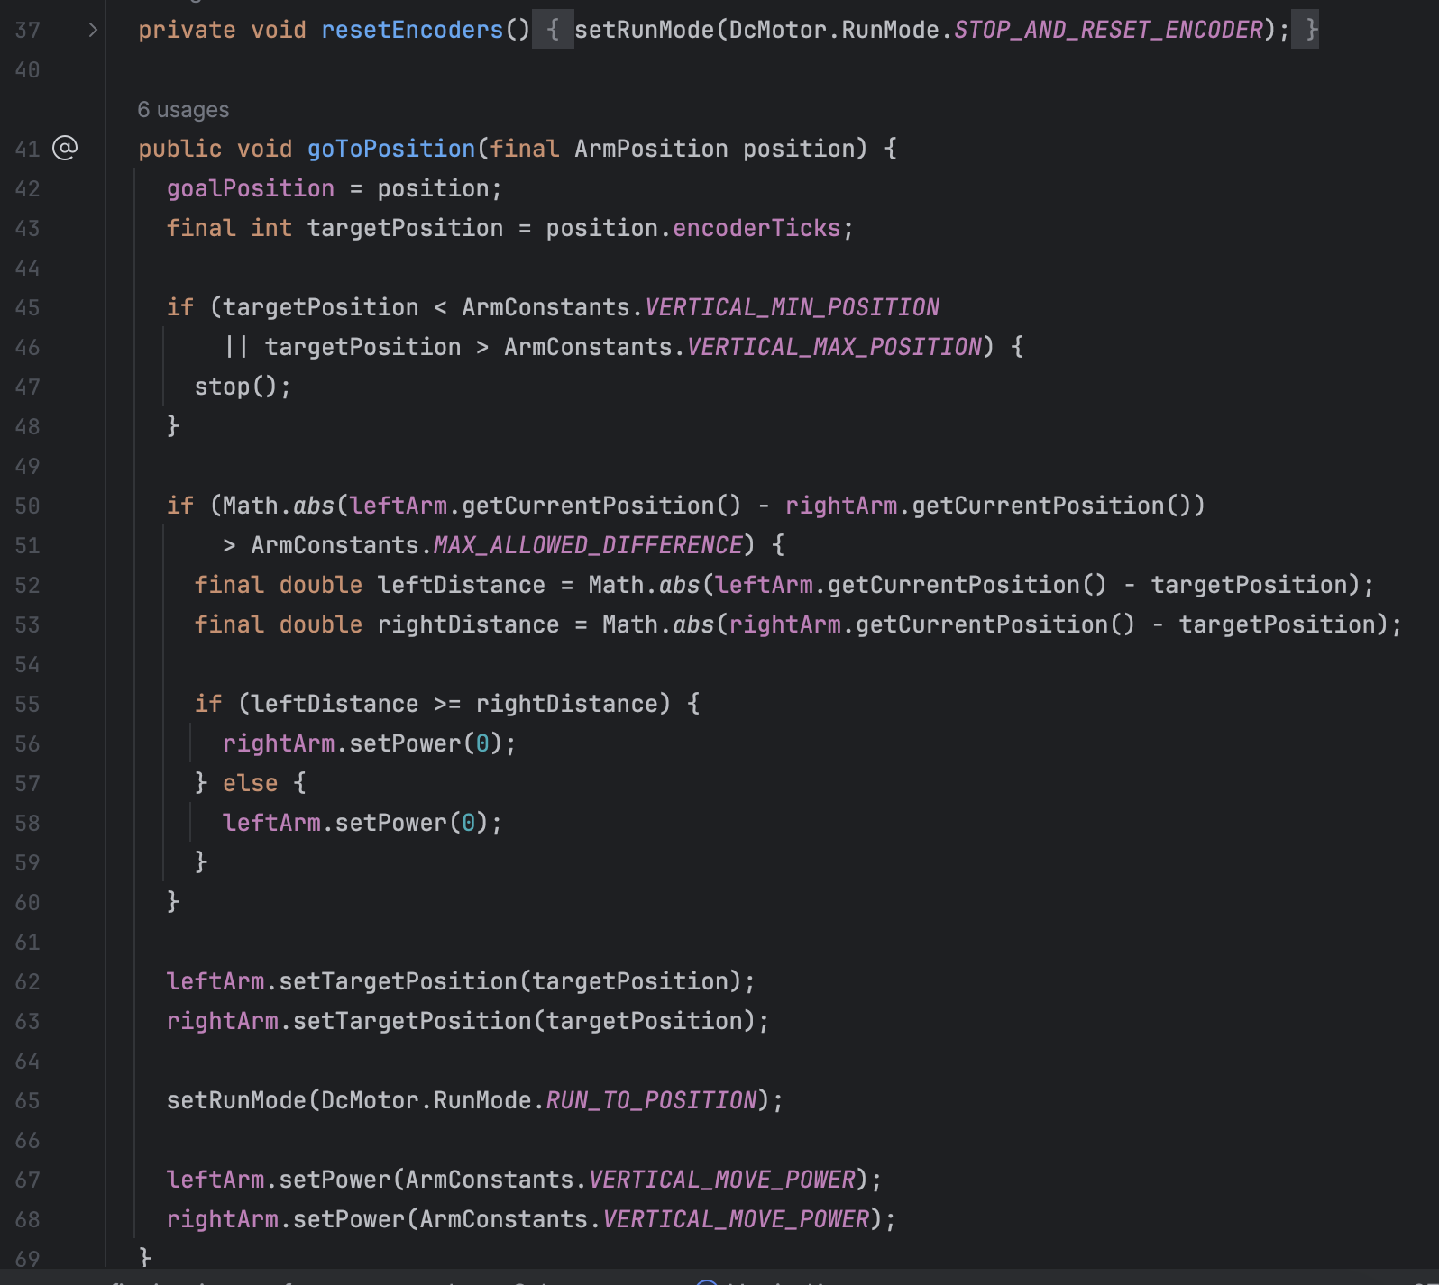
Elevator – Motors with Encoders… Why?
Elevator

Slide 27
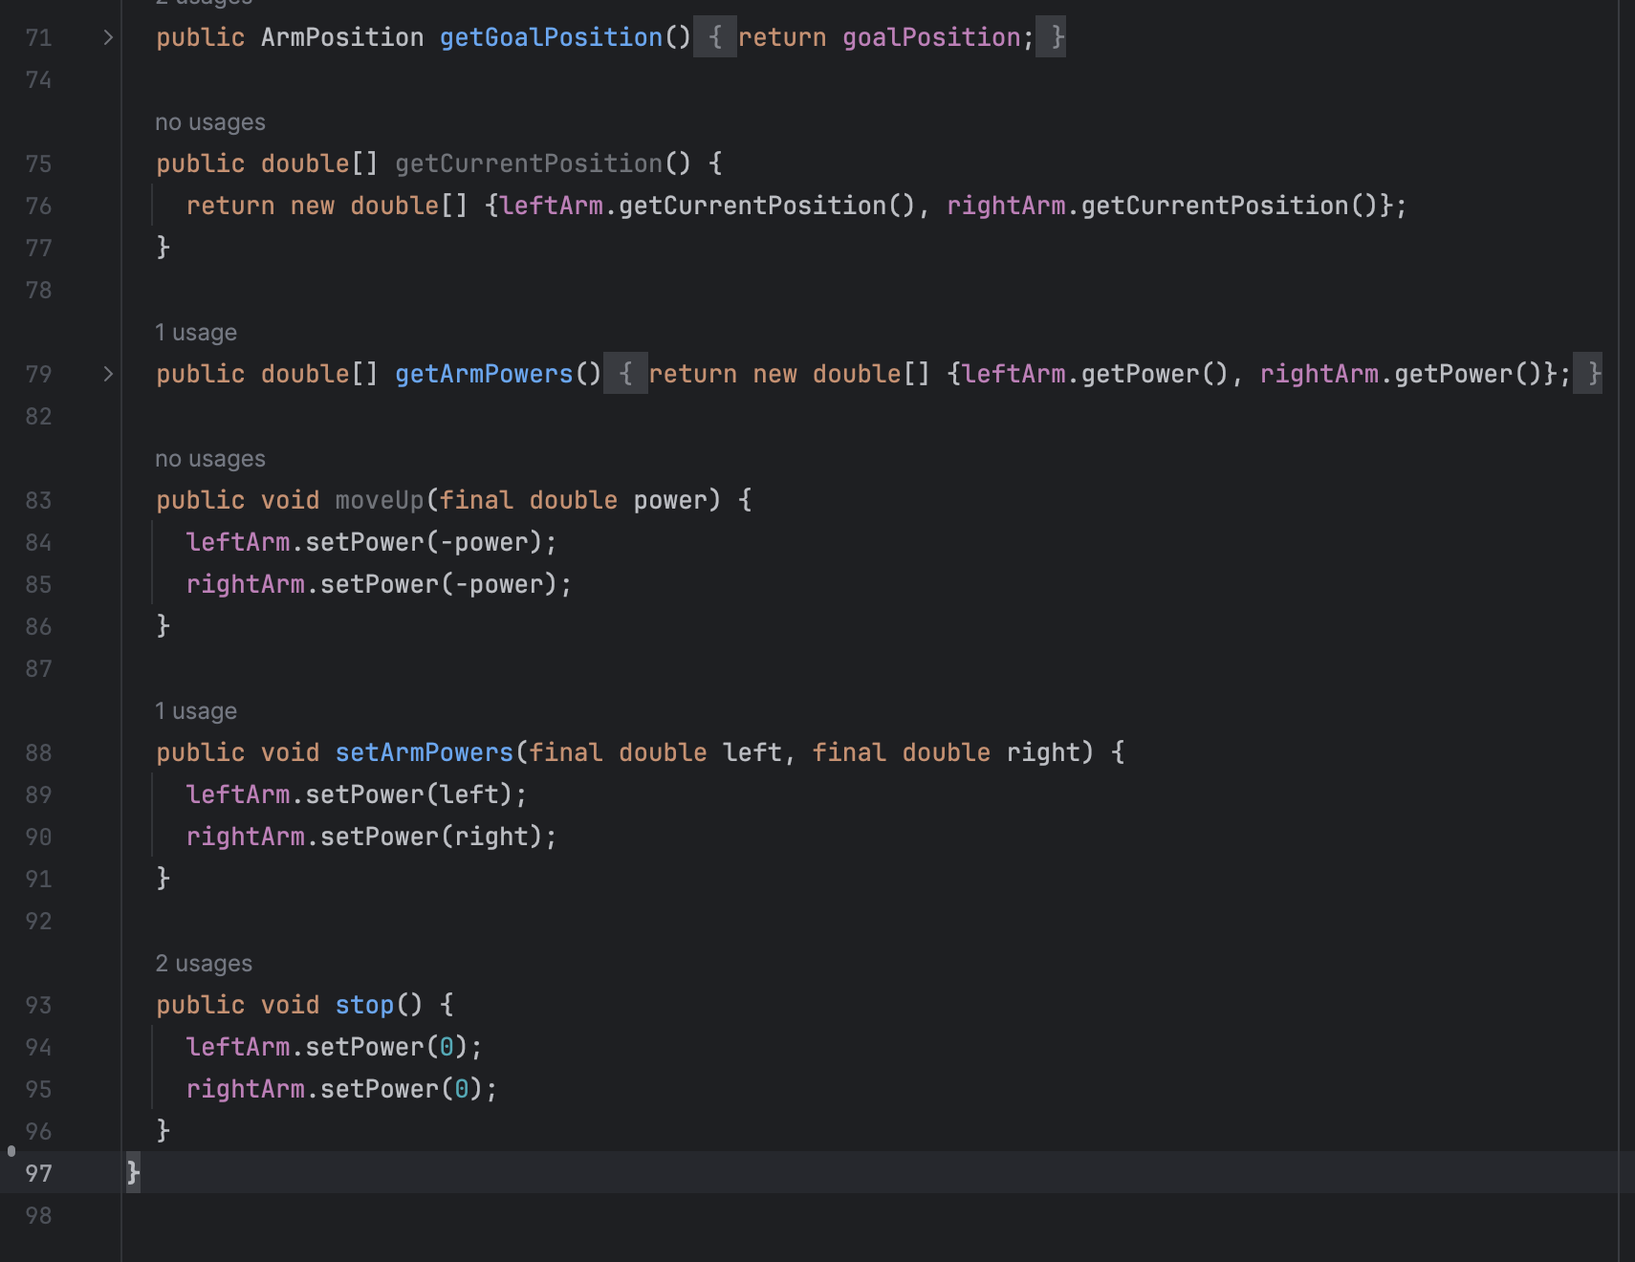
Elevator
Elevator

Slide 28
Starting the Grand Reprogram!!
99% of Programming is being your own teacher. I’ve gotten you over 50% there and given you all the answers. Can you fill in the rest?
https://github.com/Mallen220/Java-For-FTC.git
This is meant to make you familiar with our robot and how to program it. I’ve added 2 optional bonus sections (FOD and Auto) for even better understanding of Java in FTC if you would like.

